Slide 1
Final Project Big Data
Muhammad Faris Musthafa 5113100131
Agung Teguh Setyadi 5113100133
Ahmad Zaki 5113100155

Slide 2
Dataset
Video Game Sales with Ratings
Source: https://www.kaggle.com/rush4ratio/video-game-sales-with-ratings
Motivated by Gregory Smith's web scrape of VGChartz Video Games Sales, this data set simply extends the number of variables with another web scrape from Metacritic. Unfortunately, there are missing observations as Metacritic only covers a subset of the platforms. Also, a game may not have all the observations of the additional variables discussed below. Complete cases are ~ 6,900
Atributes: Name, Platform, Year_of_Release, Genre, Publisher, NA_Sales, EU_Sales, JP_Sales, Other_Sales, Global_Sales, Critic_score, Critic_count, User_score, User_count, Developer, and Rating.

Slide 3
Clustering US Sales, Japan Sales, Europe Sales, dan Other Sales using k-means
There are few pre-processings applied to dataset:
Null value handled by using pandas, a python library;
Feature selection and dimensionality reduction processed using pandas as well;
Data normalization is not necessary and there are no outlier that going to upset the mining process.
Data mining algorithm used in the mining process is Clustering using k-means.

Slide 4
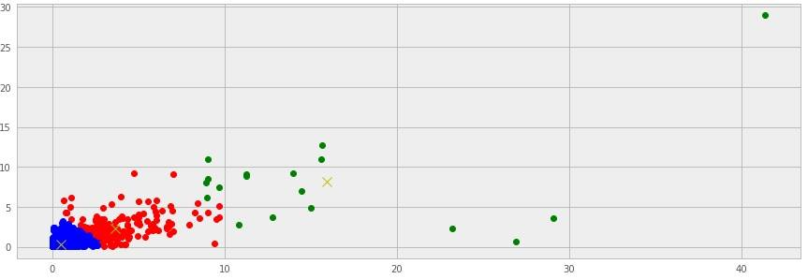
Result
[array([ 0.50772411, 0.34774268, 0.21358569, 0.11250813]), array([ 16.00333333, 8.14055556, 4.10277778, 2.08444444]), array([ 3.69434783, 2.27816425, 0.93323671, 0.75599034])]

Slide 5
Summary
Based on Clustering Result provided by above table, videos games represented by color blue have low sales number worldwide hence there are improvement work to do.

Slide 6
Frequent Pattern Mining of Sales based on Video Game Genres using FP-Growth
There are few pre-processings applied to dataset:
Feature selection and dimensionality reduction processed using pandas as well
There are no null value, data normalization is not necessary, and there are no outlier that going to upset the mining process.
Data mining algorithm used in the mining process is Frequent Pattern Mining & PF-Growth.

Slide 7
Result
FreqItemset(items=[u'Platform', u'high sales'], freq=237)
FreqItemset(items=[u'Platform', u'low sales'], freq=505)
FreqItemset(items=[u'Simulation', u'low sales'], freq=615)
FreqItemset(items=[u'Action', u'low sales'], freq=2241)
FreqItemset(items=[u'high sales', u'Action'], freq=580)
FreqItemset(items=[u'Fighting', u'high sales'], freq=173)
FreqItemset(items=[u'Fighting', u'low sales'], freq=550)
FreqItemset(items=[u'Strategy', u'low sales'], freq=556)
FreqItemset(items=[u'moderate sales', u'Action'], freq=529)
FreqItemset(items=[u'Puzzle', u'low sales'], freq=454)
FreqItemset(items=[u'Sports', u'high sales'], freq=450)
FreqItemset(items=[u'Sports', u'moderate sales'], freq=422)
FreqItemset(items=[u'Sports', u'low sales'], freq=1472)

Slide 8
Frequent Pattern Mining of Sales based on Publisher using FP-Growth
There are few pre-processings applied to dataset:
Feature selection and dimensionality reduction processed using pandas as well
There are no null value, data normalization is not necessary, and there are no outlier that going to upset the mining process.
Data mining algorithm used in the mining process is Frequent Pattern Mining & PF-Growth.

Slide 9
Result
FreqItemset(items=[u'Midway Games', u'low sales'], freq=194)
FreqItemset(items=[u'Take-Two Interactive', u'low sales'], freq=383)
FreqItemset(items=[u'Capcom', u'low sales'], freq=377)
FreqItemset(items=[u'Electronic Arts', u'low sales'], freq=1279)
FreqItemset(items=[u'505 Games', u'low sales'], freq=187)
FreqItemset(items=[u'Activision', u'low sales'], freq=924)
FreqItemset(items=[u'Microsoft Game Studios', u'low sales'], freq=173)
FreqItemset(items=[u'Atari', u'low sales'], freq=362)
FreqItemset(items=[u'Acclaim Entertainment', u'low sales'], freq=184)
FreqItemset(items=[u'Tecmo Koei', u'low sales'], freq=338)
FreqItemset(items=[u'Namco Bandai Games', u'low sales'], freq=927)
FreqItemset(items=[u'Ubisoft', u'low sales'], freq=895)

